Slide 1
ADAPTATIONS OF THE ARCTIC FOX (Vulpes lagopus) TO THE POLAR WINTER
GROUP 12

Slide 2
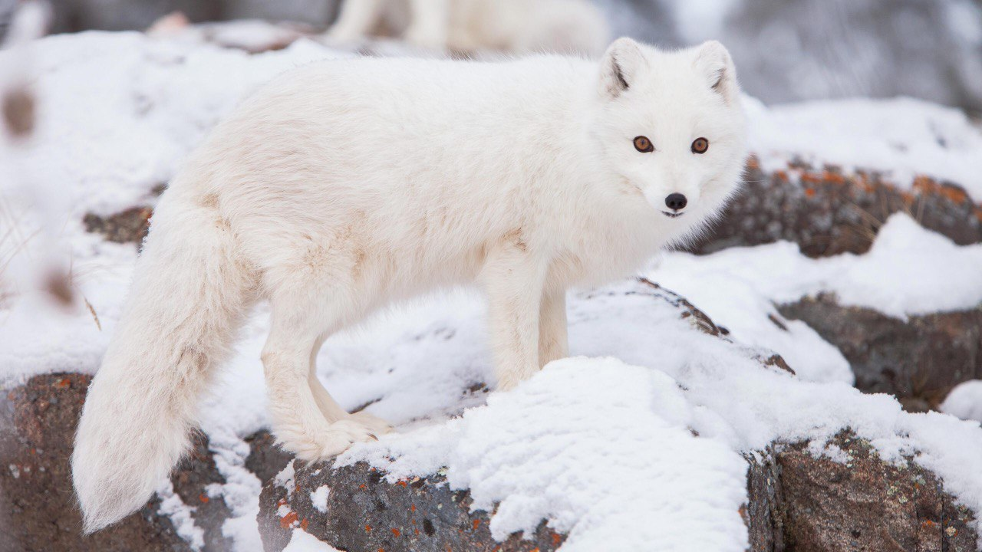

Slide 3
OUTLINE
INTRODUCTION
STRUCTURAL CHARACTERISTICS
BEHAVIOURAL ADAPTATION
PHYSIOLOGICAL ADAPTATION
ADAPTATION TO FOOD SCARCITY
CONCLUSION
REFERNCES

Slide 4
INTRODUCTION
The arctic fox (Vulpes lagopus) is a small mammal found throughout the arctic tundra of Eurasia and North America.
The winter climate is characterized by low temperatures, snow fall, frequent strong winds and darkness during part of the winter
Despite these seemingly inhospitable conditions, arctic foxes live and reproduce successfully.

Slide 5
STRUCTURAL CHARACTERISTICS
Relatively small
Short legs
Short muzzle
Small, round ears
Thick fur
Fur covered footpads
Thick tail

Slide 6
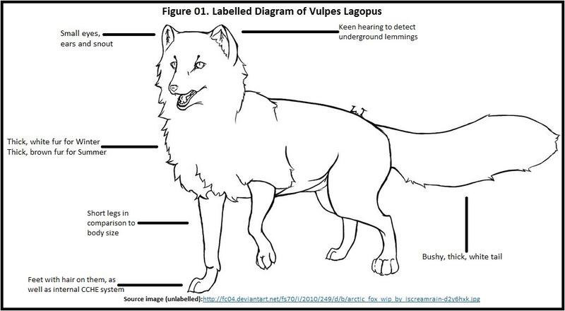

Slide 7
BEHAVIOURAL ADAPTATIONS
Solitary Behaviour
Family Group Formation
Denning
Vocal Communication
Color change camouflage

Slide 8
PHYSIOLOGICAL ADAPTATIONS
Insulating fur
Counter-current heat exchange system
Reduced surface area-to-volume ratio
Lowered metabolic rate
Gestation delay

Slide 9
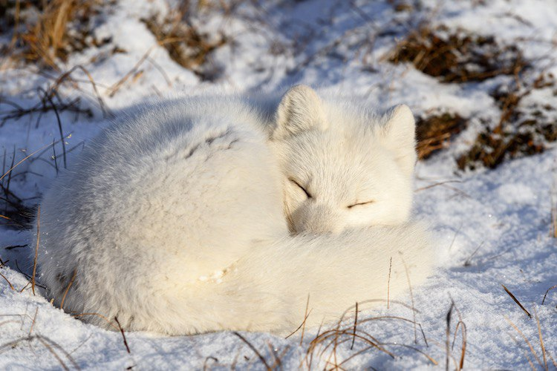
Fig. 2 Fox curls up to minimize heat loss

Slide 10
ADAPTATION TO FOOD SCARCITY
Food caching
Nomadic behaviour
Changing diet with seasons
Seasonal migration
Scavenging

Slide 11
CONCLUSION
These adaptations collectively equip the Arctic fox with tools necessary to endure the extreme conductions of the polar regions and ensure their survival in one of the most challenging environments in the world.
However climate change and human activities pose increasing threat to their habitat and survival.

Slide 12
REFERENCES
Pal Prestrud. Adaptations by the Arctic Fox to the Polar Winter,Vol.44, No. 2 (June 1991).
Anders. A, Pall. H & Magnus. T, “ Consequences of resource predictability in the Arctic Fox” Chapter 8 (2004).
https://allthingsfoxes.com arctic fox.

Slide 13
GROUP MEMBERS
QUASHIE ANABEL
BANGYA LOIS MBAMAH
MENSAH GLORIA NAA
BOATENG PORTIA
INUSAH ABDUL-BASIT
OWUSU-YEBOAH DANIEL
HUKPORTIE VINCENT MENSAH

Slide 14


